Slide 1


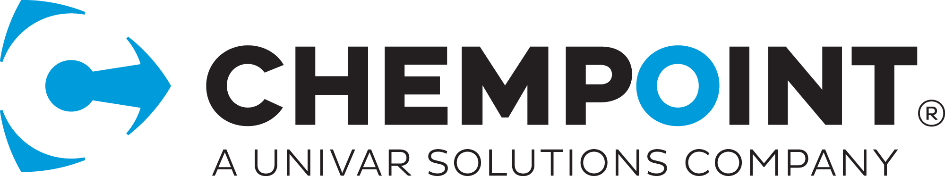
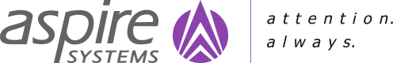
DMS Technical Architecture

Slide 2


SCOPE of WORK - summary
Storage and Document Management
Document Organization. By regionality, doc type etc.
Document indexing and architecture
Manual document upload
Upload Email Attachments
Document management / Approval workflow
Document group\type specific workflow (SDS, TDS)
Migrate SharePoint document repositories into new platform
Reporting and Views
Download PDF functionality
Automated expiry and archiving
Robust navigation and search
Connector with existing Integration End-Points
Configurable Access and Permission
Security and Infrastructure features
Document management governance
Search by Document Contents
Document Splitting
Request for missing documents
To classify “top priority” documents
Identify entities
Extract Document Data
Understand the document context

Slide 3







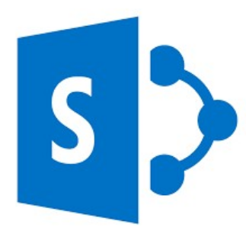






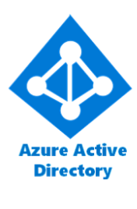



SOLUTION Approach - Diagram
DMS Front-End
Web Application
Service Layer
Client Applications
API Gateway
Split/Extraction Service
AI/ML Engine
Email with Attachment
Product Pedia
Identity Provider
SCSi Board
Document Upload Service
Power Automate
PDSI Board API
XRM Application
Meta Data
Document Organizer Service
Product Pedia
Document Storage Service
Azure Storage
My Chempoint
Identity Provider
Archive
Request/Download Link
Document Download Service
SharePoint Online
DMS
Whi Board
On-premises
Active Directory
Document
Document Conversion Service
XRM Application
Sync
Product Point
Document Query/Results
Document Search Service
Azure Active Directory
Chempoint.com
Identity Provider
Document Links Service
Morpheus Reports
Internal Users/Admin

Slide 4

DMS Front-end Web Application
Document Upload Form
Document Download Link
Document Search
Document Links
Document Query
Request/Download Link
Links & Metadata
Links & Metadata
Links & Metadata
.
Document Metadata & Details
Link
Links & Metadata
Document
Links & Metadata
Meta Data
Document Metadata & Details
Link
Document Metadata & Details
Link
Upload Single / Multiple Document
Document Thumbnails for preview
Provision for add/Edit Metadata
Validations for Metadata fields
Drag & drop documents
Pre-populate the metadata based on external application
Split 1 document to multiple
Custom Download link for each document
Request link validated based on external application access token
Send request to service layer and receive the valid document
Provision for Multiple documents download
Option to send download request to admin
Document can be searched from the DMS Front-end Application
Search results will be returned based on query.
Results page has features like filter and refineries.
To get all document links and metadata based on Product line or Document type
Applications can show the document links, Even the user don’t have access to download
Reporting tools can retrieve the data for generating the reports based on documents.

Slide 5

Solution Approach
DMS Front-end will be created using React web application
DMS Front-end will be hosted in Azure as a Web App
All External Application will use DMS Front-end as an embedded component using the application URL
Authentication and authorization will be done using Application token
DMS admin interface will be developed using SharePoint Framework (SPFx)
Document Service will be created using .NET Core API and hosted in Azure as Web Service
Document Service will be authorized using OAuth authentication
Document Service will be secured using Azure Security policy
Single Sign on for SharePoint will be implemented using Pass-Through Authentication
Migration will be done using ShareGate tool.
Email attachments will be processed using Power Automate scheduler workflow and will consume Document service to upload documents
Documents Service will consume AI/ML engine for Document classification and Data extraction
PDSiboard Product Line hierarchy will be synced to SharePoint online using Power Automate scheduler workflow
Archived documents will be stored in azure storage

Slide 6





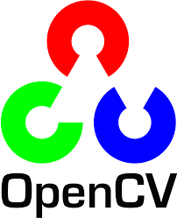

AI Engine- reference architecture
Bulk Document
Image
Ingestion
Image Classification
Recognized Object
Python Web
Services
Real time
Doc image
Scan
(UI Layer
Mobile /
Tablet App)
Image
Processing
Object Recognition
Image Detection &
Segmentation
Data Extraction Apply Tesseract to Extract Data
Convolutional Neural Nets
Misclassification
Treatment
Recognized Object
(UI Layer
NLP Engine
Object Localization
Text classification
Contextual search
Presentation Layer (React/Flask/Django)

Slide 7

AI/ML Module & Features List
AI driven Document data Extraction model trained on the ingested document images(scanned copies) , to perform document classification, Object Localization, Object Detection and Finally Image Segmentation
Batch process to train on existing set of document images and classify them into various classes/labels.
Perform Image processing to cleanse the documents with noise.
Real time Document Search – During the search workflow for a specific document, the AI algorithm will be able to give the contextual search results
Real Time document Recognition - Algorithm will be fine tuned to return only those image identifiers that have the highest matched probabilities
The document recognition will be done during the uploading of the document
Information of summarized documents or topic models will also be stored as meta data information
Pre-specified entities for each document type will be extracted by the AI algorithm and stored as meta data information in No SqL

Slide 8

Site Structure and library hierarchy
Document Group Site
Year Folder
Document Type Library
Product line Folder
Application Site Collection
Application Site Collection
Document Group Site
Year Folder
Document Type Library
Product line Folder
Application Hub
Site
Hierarchy
Levels
Application
Document Type
Product Line
Hub Site
Document Group
Year
Phase 1 – Library
Document Library Phases
Keeps last 6-months documents
Active Document Library
Old Document library
Phase 2– Library
Phase 1
Phase 3
Keeps 1 to 2 years documents
Mid-age document library
Phase 3– Library
Phase 2
Older than 2 years documents
Notes:
Each external applications will be considered as Site Collection
All site collection will be connected to Application Hub Site
Under each site collection document groups will be created as Subsite
Under each subsite each document type will be created as Document Library
Under each document library each year will be created as Folder
Under each year folder each product Line item will be created as Folder
Each document library will be considering as Three phases
Recent Document Library will have last 6-month documents
Mid-age document library will have 1 – 2 years document
Old Document library will have the documents which older than 2 years

Slide 9



Archival strategy
1
Archival Level 1
Documents which will be in primary, secondary and tertiary buckets of document libraries and will be actively accessed by the applications such as XRM.
Primary
Document Library
Secondary
Document Library
Tertiary
Document Library
1
2
Archival Level 2
Documents which won’t be accessed by applications but will be retained as records in Record center which will be available only for the admins.
Tertiary
Document Library
2
SharePoint Record Center
3
Archival Level 3
Documents which won’t be accessed by admin and applications , should be persisted in cold storage for compliance purpose.
3
SharePoint Record Center
Azure Cloud Storage

Slide 10
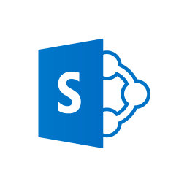


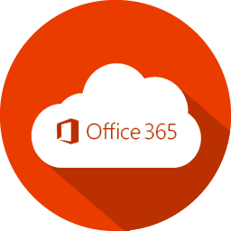
Backup strategy
Serialize and export the document libraries to an agreed format using Third party tools like CodeTwo/CloudAlly
Serialize & Store
to File Share
Store the serialized documents to a cold storage – Azure Cloud Storage
Using CodeTwo
Desktop Application
SharePoint Online
Document Library
Deserialize
and Restore
Azure Cloud Storage
In case if the documents need to be restored to a O365 SharePoint document library in the future, then import back the serialized content to O365 SharePoint document library using Third party tools like CodeTwo/CloudAlly
Using CodeTwo
Desktop Application
Custom Backup Solution using CodeTwo Application

Slide 11
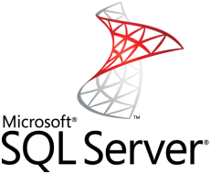
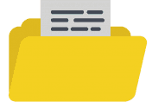
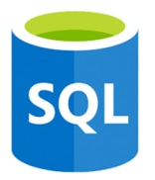


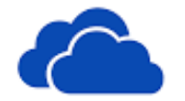
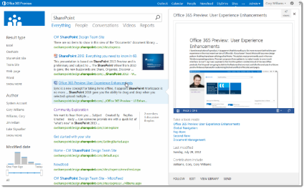

Search strategy
Microsoft
Connectors
Custom
Connectors
File Share
Microsoft Graph Connector API
Azure SQL
Enterprise websites
Microsoft Search Service
Azure Data Lake
OneDrive
SharePoint
Pages/List &Library
Microsoft Search Query Search API
User
Custom Results Page
with filter & Refineries

Slide 12
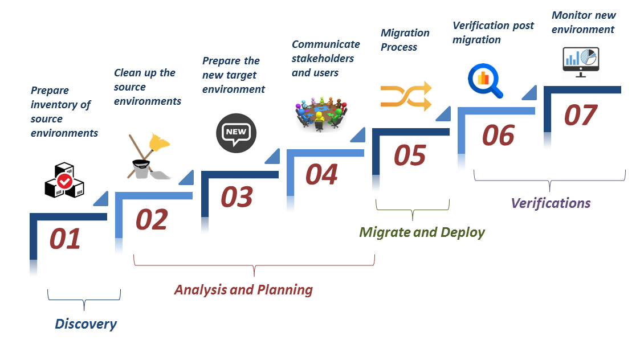
Migration strategy
NOTE
A correct Migration Strategy can be developed after analyzing the source systems and the content to be migrated.
Generally we recommend a combined migration approach with manual efforts and also using a third party migration tool.
The documents and content can be moved faster with a custom coded solution offered by third party tools without any hassle.
While the custom solutions that needs greater precautions while migrating can be migrated manually to avoid any chances of errors in business functionality post migration.

Slide 13

Governance model
NOTE
Site Structure and Hierarchy
Site Policies
1
2
A good governance plan can
Streamline the deployment of SharePoint Solution
Help keep your organization's system secure and compliant
Help ensure the best return on your investment in technology
13
3
Site Quota
Search
12
4
Archiving
User Profile
Managed
Metadata
11
5
Security and Permissions
Download the complete Governance Plan here.
10
Records
Management
6
User Management
9
7
8
Site Management and Site Owner Authority
Auditing
Document Management

Slide 14
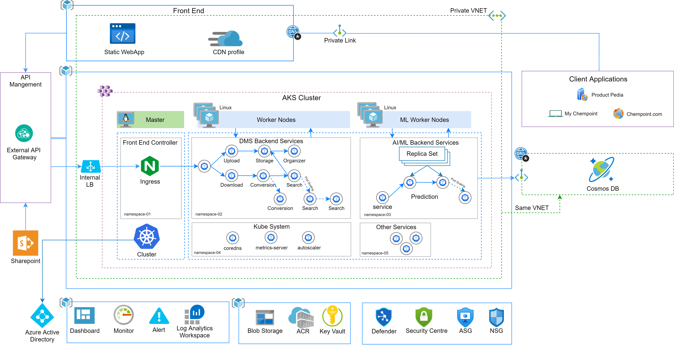
Deployment architecture

Slide 15
Deployment approach
DMS Front-end will be hosted in an Azure Static web app with storage blob as content storage. Azure CDN will be configured for cache management
Static Web App & CDN will be created in a separate resource group
Private Link will be configured for the DMS front end. All the external/client applications will access the private endpoint only
AKS cluster will be created with 2 agent pools. Each agent pool will have 1 or worker nodes based on the bandwidth required
AKS cluster & Agent pools will be created in a same resource group
DMS service APIs will be deployed on a Linux worker nodes (e.g. agent pool name - coreapi)
AI/ML service API will be hosted in a separate Linux worker nodes (e.g. agent pool name - aimlapi)
AI/ML worker node spec will be bit higher than coreapi agent pool since it might require more compute resource
Cosmos DB (NoSQL) will be used as a backend to the AI/ML APIs. This will be created in a same VNET as the AKS cluster
Private link will be configured for the Cosmos DB. Cluster resource should be able to access the DB through private endpoint

Slide 16
Deployment approach
NGINX will be used a internal load balancer to serve the ingress traffic
External API gateway can access the cluster resource/containers through the ingress controller using private endpoint
Private DNS & SSL certificates will be configured to facilitate secure access using FQDN
Azure monitor will be used for monitoring the AKS cluster, pod status
Azure log analytics workspace will be used for archiving the cluster resource logs
Azure alerts will be configured for common alerting policy to the project stakeholders
All the monitoring services will be created in a same resource group
Azure storage blob will be used as a storage for DMS front end
We will be Azure blob/file share as a Persistent Volume for the DMS API containers
Azure key vault will be used for securely accessing/managing the secrets during the runtime
Each subnets in the DMS VNET will be configured with a Network Security Group
Also, we will configure Application Security Group to scrutinize the inbound traffic from other subnets
Azure Security center will be configured to protect all the resources used in the DMS infrastructure

Slide 17
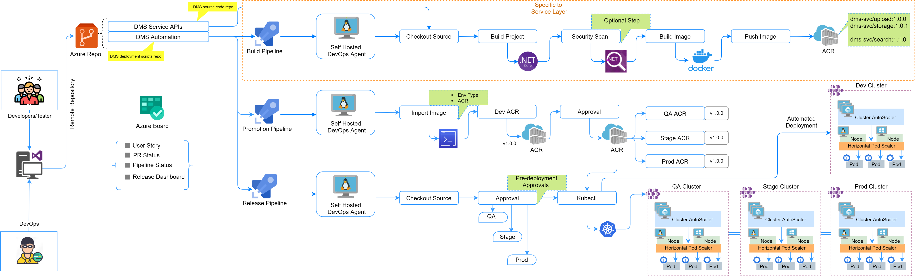
CICD for DMS Service layer & AI Engine
* Promotion and Release pipelines will be common for Service APIs & AI Engine

Slide 18
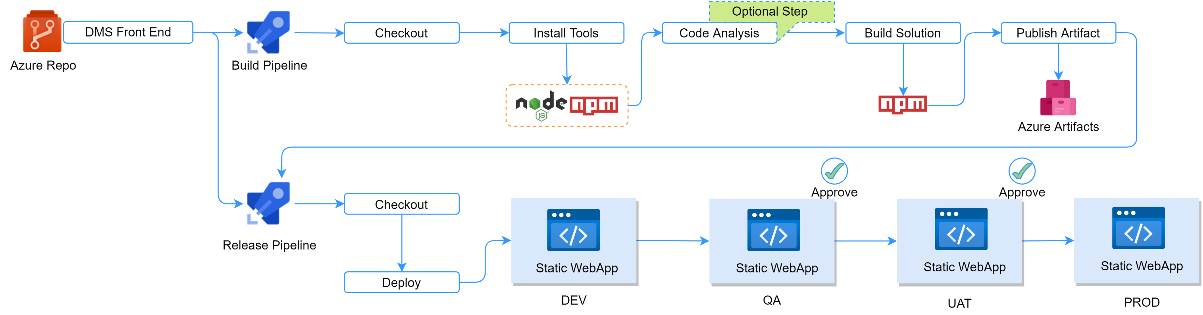
CICD for DMS front end

Slide 19
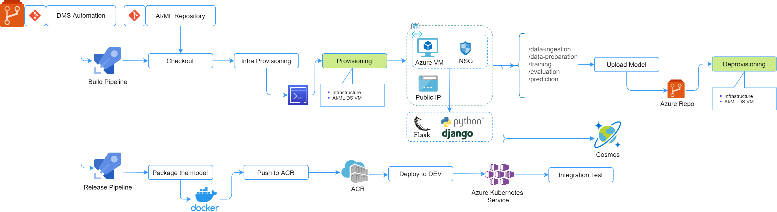
Ai/ML engine training pipeline
* Use of Deployment platform & data model storage will be discussed

Slide 20
VNET & SUBNET SECURITY
Subnet, Network Security Group
DMS frontend application, AKS cluster, Cosmos DB will be created in a separate subnets
API Gateway
We are assuming API gateway is hosted in the data center and it will communicate to internal endpoint of API Load balancer using the private route
Enable NSG rules to allow or deny the network traffic to Azure resources
By default NSG rules will be deny all for Inbound .
For API incoming traffic will be allowed only in IP range of API
All NSG rules will be documented and changes will go through approval.
Create NSG(Network Security Group) on Subnet level
Clear segregation of subnet public(DMZ) and Private subnet(App and DB)
Create ASG to restrict the inbound traffic to the subnets
We are assuming DDOS and WAF protection will be utilized from DELL Boomi API gateway
Create a private end point for Cosmos DB and Blob Storage in the same VNET as AKS cluster worker nodes.

Slide 21
Container images & ACR SECURITY
Container Images
We will use the official base image while building our containers
Azure Container Registry
No unnecessary ports will be opened in the containers
No unnecessary packages will be installed in the containers
No sensitive information will be hard coded in the Dockerfile
Dockerfile will be versioned in the Azure DevOps repository
Container image changes will be approved through Peer Review
Azure Defender will be enabled to scan the container images pushed into the ACR for vulnerabilities
CVEs, CVSS scores will be monitored in the security center
Disable ACR Admin user
Authorize using service principal
Create the IAM roles with policy of POLP with access to the respective ACR Images
Enable content trust to sign the images before pushing into registry

Slide 22
Web app SECURITY
Static WebApp
Azure Static Web App Service will configured with private link.
Azure CDN
Azure CDN will be accessed through private endpoint
Azure defender will be enabled to detect the multitude of threats of App Service resources
Communication of secrets (such as connection strings) between the app and other Azure resources like AKS will be encrypted.
SSL for custom domain will be Implemented
Diagnostic logs will be enabled in in App Service
Detects file download from a know malicious source
Connection to web page from anomalous IP address detected
Token authentication will be configured
Access to this resource will be restricted with IAM policy

Slide 23
AKS SECURITY
Kubernetes Cluster
RBAC
Ingress Controller
All inbound traffic to the pods will be accessed through NGINX ingress controller
We will enable AKS RBAC which will restrict access to Kubernetes API, cluster resources through AD roles and permission
Upgrade and Patch Management
AKS cluster auto-upgrade will be enabled to apply security patches automatically
Threat Detection
Azure Defender for Kubernetes provides cluster-level threat protection by monitoring your clusters' logs
Secret Management
We will use Azure key vaults to securely store the secrets/sensitive data
The ingress controller endpoint should be private but if any external application needs to communicate bi-directionally then we need to enable public endpoint
SSL configuration will be done on the ingress controller level or pod level using Private DNS FQDN
TLS 1.3 termination will be preferred

Slide 24
Azure DevOps security
Build Pipeline
Release Pipeline
We will integrate Azure Key vault with Azure DevOps pipeline for fetching the secrets during the runtime
RBAC will be implemented in the Azure DevOps organization
Developers & Testers will be granted least privilege to access the Azure DevOps repo & pipelines
Master branch will be locked. No commit/build allowed into the master branch
Build artifacts will be stored internally within the Azure DevOps organization
Azure artifacts access will be restricted
Azure DevOps pipeline & Azure subscription authorization will be handled with Service Principal
Least privileges will be assigned to the Azure service principal
Deploying new release through this pipeline will be authorized using service principal
Release pipeline will have multiple levels of approvals in QA, UAT and Prod deployments

Slide 25
Logging & Monitoring
Monitoring
Logging
Azure App Insights will be used for application level monitoring
Azure monitor shall be used for collecting container metrics
Attack telemetry will be identified through azure monitor
Common Alerting will be configured to get notified when there is an incident/change in the normal behavior
Container logs will be stored in the log analytics workspace
Customer metrics will be created

Slide 26
security Center & defender
Azure Security Center
Security center covers two features
Azure defender mainly covering the CWP feature of security center
Azure Defender
Cloud security posture management (CSPM)
Cloud workload protection (CWP)
Any known security flaws in the DMS infrastructure will be identified through security center reports & recommendations
Unified dashboard will give clear view of infrastructure inventory & security alerts
We will use this service for securing the ACR container images, worker nodes , key vault and storage

Slide 27
COMPARISON WITH 3rd party TOOLS
Clair
Azure Security Center
Tools Integrate with Azure Security center Linux and Windows
Tools Integrate with Prisma Cloud react,Slack,AngulaJS.
Azure defender for Kubernetes cost = 0.00268/vCore/hour. We required 8 cores per month which cost $16.00 per month.
It is a unified infrastructure security management system that strengthens the security posture of your data centers, and provides advanced threat protection across your hybrid workloads in the cloud - whether they're in Azure or not - as well as on premises.
It's not really on par with, or catering to, what other products are looking at in terms of SAST and DAST capabilities
The feedback that we have given to the Palo Alto team is that the UI can be improved. When you press the "back" button on your browser from the Investigate tab, the query that you're working on just disappears.
Prisma
1 Container defender requires =7 Credits per month.
10 conatainer =70 Credits.
100 Credits=$9000.
70 Credits= $6300
Clair is an open-source project which offers static security and vulnerability scanning for docker and application containers.
It notifies you about a potential threat in the container based on the Common Vulnerabilities and Exposures database(CVE) and similar databases.
Scans for existing vulnerabilities and prevents them from being introduced in the future.

Slide 28
Price COMPARISON -AKS Worker Node OS
O.S | Instance | Virtual Machines | Price(1Year Reserved) | Pay as you go | 3 year reserved
Linux | D4 V3:4Vcpu,16GB RAM, 32GB Temporary Storage $0.234/hour | 2 | $ 231.83 per month | $ 341.64 per month | $ 148.22 per month
Windows | D4 V3:4Vcpu,16GB RAM, 32GB Temporary Storage $0.234/hour | 2 | $ 610.28 per month | $ 500.47 per month | $ 416.86 per month

Slide 29
DevOps assumptions
DMS Application and API Services will be developed as micro services (container native)
A dedicated pipeline can be created for Training the AI engine on demand
Service Oriented Architecture
AI Engine Training
We assumed Azure DevOps, AKS, AppService can be used as it fits the requirements
Promotion and Release pipeline will be common for service API’s & AI Engine
Choice of Infra & Automation Tech stack
Promotion & Release
We recommend DEV, QA, STAGE and PROD environments for the efficient build & release
Application Environments
Network & VPN dependency
Integration of other on-prem servers / cloud services requires join effort

Slide 30
Thank you :)

Slide 31
Azure Tools Pricing
Azure Defender Pricing
Resource Type | Price
Azure Defender for Servers | $14.60/Server/month
 | Included data - 500 MB/day
Azure Defender for App Service | $14.60/App Service/month
Azure Defender for SQL on Azure | $15/Instance/month2
Azure Defender for SQL outside Azure | $10.95/vCore/month3
Azure Defender for MySQL | $15/Instance/month
Azure Defender for PostgreSQL | $15/Instance/month
Azure Defender for MariaDB | $14.746/Instance/month
Azure Defender for Storage - Protect all storage accounts within a subscription1 | $0.02/10K transactions
Azure Defender for Kubernetes | $0.00268/vCore/hour
Azure Defender for ACR | $0.29/image
Azure Defender for Key Vault | $0.02/10K transactions
Azure Defender for ARM (Preview) | Free
Azure Defender for DNS | $0.70/1M Queries

